Slide 1
Computer Graphics
Rewan deabes

Slide 2

Turtle

Slide 3
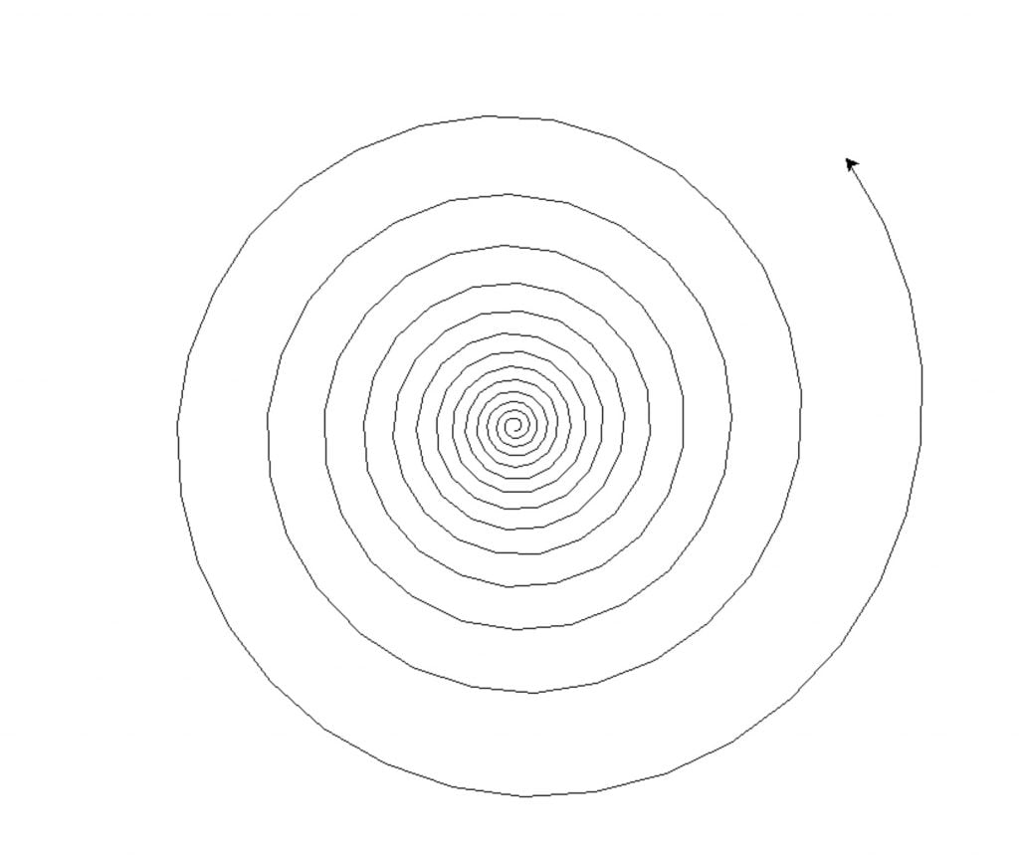
Question 1 :-

Slide 4
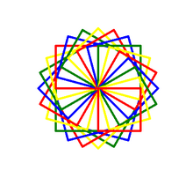
Question 2 :-

Slide 5

Question 3 :-

Slide 6
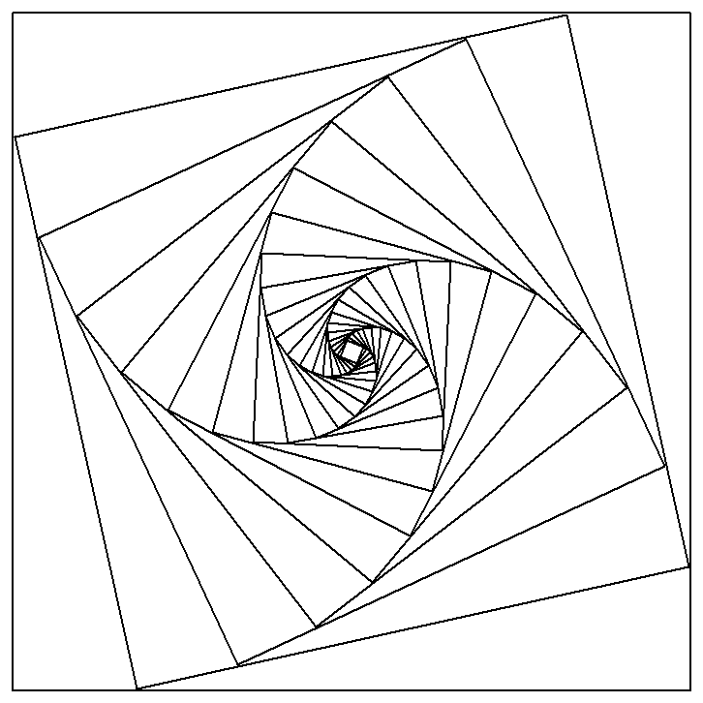
Question 4 :-

Slide 7
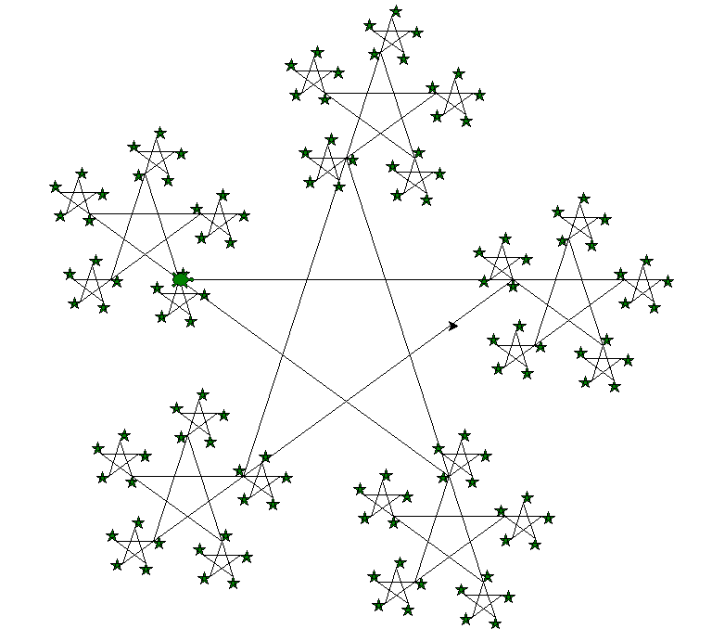
Question 5 :-

Slide 8
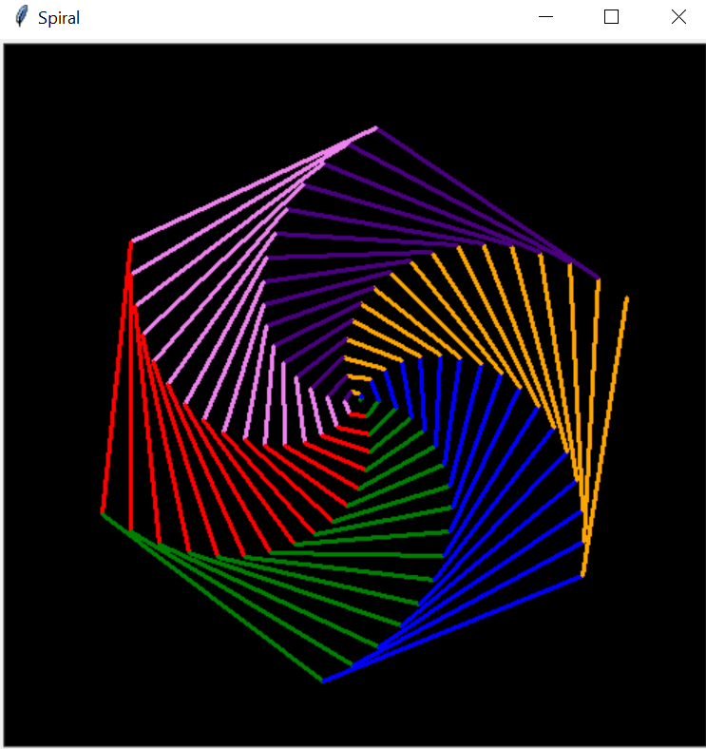
Question 6 :-

Slide 9
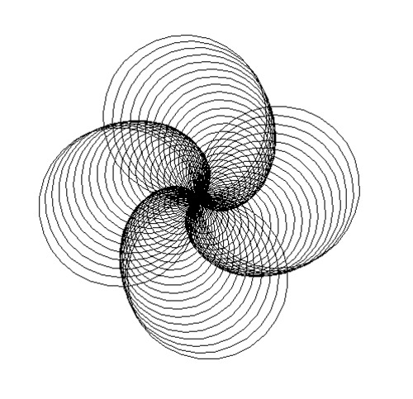
Question 7 :-

Slide 10
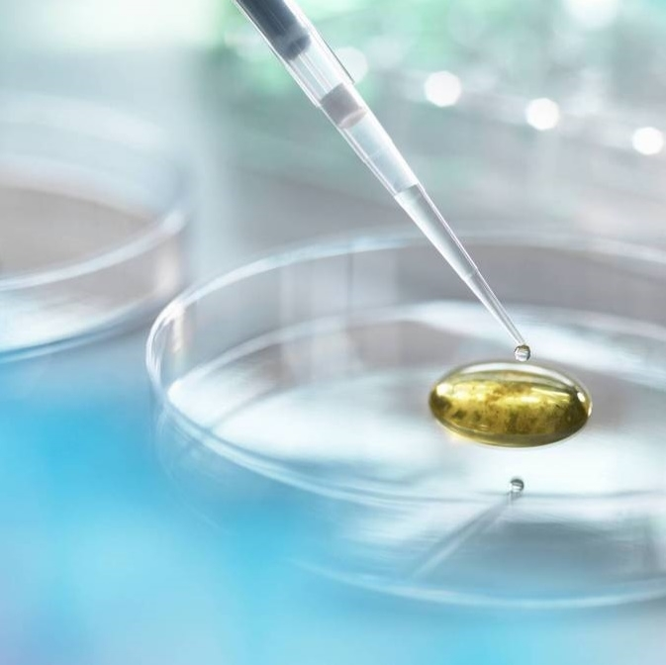
Thank you

